Slide 1
Advanced Lane Detection
Ravina Lad
Lad.ra@northestern.edu

Slide 2
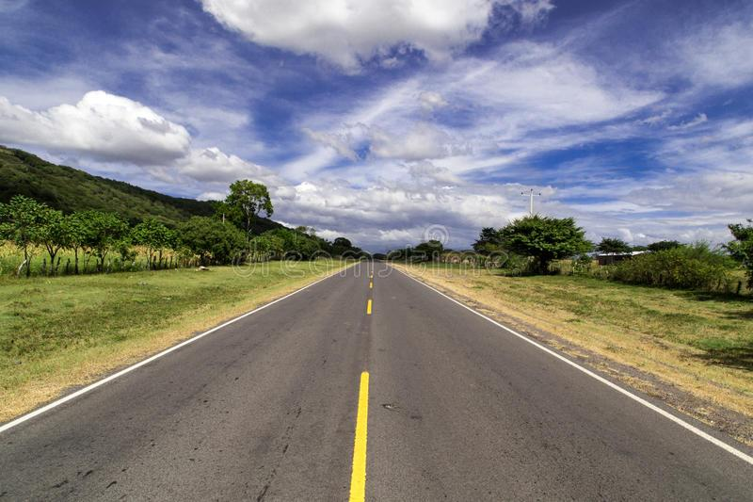
Introduction
In the world of autonomous systems to visualize the surroundings, computer vision plays the most important role. This paper explains the process involved in lane detection using different computer vision techniques like camera calibration, perspective transform, binary image thresholding, finding lane pixels, and recognizing the lane area. The end result of this paper is to find the radius of lane curvature. This paper does not include any neural network system. In the project, we will build a pipeline to identify lane boundaries in a video from a front facing camera mounted on a car. It will detect lanes in conditions like curved roads.

Slide 3
Motivation
In the field of Advanced Driver assistive systems, lane departure detection plays an important role. It also helps to improve the vehicle's safe driving. Road accidents are a major problem worldwide. The detection of the lane works as a warning system. Therefore, in order to avoid over speeding of the vehicles during the turning on the curved roads, it is necessary to detect lanes. This paper includes python programming language and for pre-processing the frame from video openCV is utilized. The highlighted pipeline was designed to operate in below scenarios:
If only one of two lane lines have been successfully detected, then the detection is considered invalid and will be discarded. In this case, the pipeline will instead output a lane line fit (for both left and right) based on the moving average of the previous detections.
It can detect exactly two lane lines, i.e. the left and right lane boundaries of the lane the vehicle is currently driving in.onents, such as multi-leveled equations, graphics, and tables are not prescribed, although the various table text styles are provided. The formatter will need to create these components, incorporating the applicable criteria that follow.

Slide 4
Related Work
This section talks about the current-state-of-art and different proposed methods given by different scholars.
L. Mao et al [1] and C. Ma. uses a Heuristic search method to detect lane boundaries. They do this by converting GB image into Lab color space and Heuristic Search technique narrowing the search region, this algorithm is powerful and compatible to the particular road conditions.
J. Baili et al. [2] converts the ROI into YCbCr color space. Horizontal differencing filter is used to detect edges. The modified Hough transform algorithm sorts the edge point into lines. When there is a modification in the road lane, the tracking mode has to be upgraded.
Qing Lin et al. [3] This paper detects lane positions and lane marks. It uses the technique which extracts the lane mark candidates within the input frame through using a prolonged edge link algorithm.It combines lane-mark and edge-link capabilities that are edge-link features that are orientation and width.
K. Dinakaran. Stephen SagayarajS.K. KabileshT. ManiA. AnandkumarGokul Chandrasekaran [4] This paper is quite similar to the approach that I followed but there are many prominent changes such as: they have developed two different models to detect curved and straight lanes. They use improved hough transformation to detect straight lines while curve fitting method is proposed to detect curved road lanes. They also perform Sobel thresholding on HLS converted input images.

Slide 5
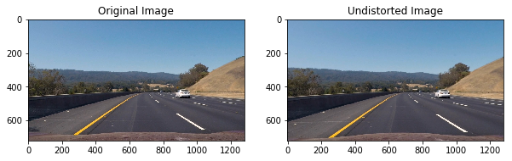
Methods
All cameras use lenses and radial distortion is the main problem with lenses. When lenses focus light rays on the sensor to capture wide images, these light rays tend to blend at the edge of the convex or curved lens of the camera due to the effect of refraction. Furthermore, this effect leads to distorting the images, that is they appear more or less like curved lines than they actually are. To remove radial distortion, this paper uses chessboard images to calculate distortion coefficients and camera matrix. To find the intrinsic camera parameters, first find the inside corners within the chessboard images and use those parameters to un-distort the test image of straight lanes of road images.
We can use five distortion coefficients k1, k2, p1, p2 and k3 to undistort the images from the video frame. I have used (k1, k2, k3) to correct radial distortion. Object points that are (x,y,z) coordinates of the chessboard corners in the world. Chessboard is fixed at (x,y) keeping z zero and I assume that object points will be the same for each calibration image. Img Points will be appended with the (x, y) pixel position of each of the corners in the image plane with each successful chessboard detection. I then used the output obj points and img points to compute the camera calibration and distortion coefficients using the cv2.calibrateCamera() function. I applied this distortion correction to the test image using the cv2.undistort() function.
1) Camera Calibration

Slide 6
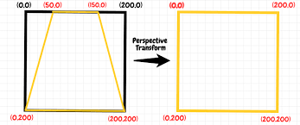
2) Perspective Transform
The first step in detecting lanes is to align our visual systems to visualize the road ahead in a manner that they seem to be looking at it from a bird’s eye perspective, this will help in calculating the curvature of the road, as a result, will help us predict the steering angle for the next few hundred meters. The other benefit of top-down view is it fixes the issue where lane lines seem to merge whereas lane lines are infinitely parallel lines as long as the road runs. The bird’s eye view can be achieved by applying the perspective transform, essentially mapping a set of four points bounding the lane area in our input image to the desired set of points, thus generating the desired top-down view. These points are determined on a case-to-case basis, the determining factors are mainly the position of the camera in the vehicle and its field of view.
The function cv2. PerspectiveTransform will change the viewpoint. This transform does not preserve length, angle, and parallelism. This means that the straight lines will remain straight after the transformation. We make use of a function called cv2.warpPerspective() function to fit the size of the resulting image by using the cv2.getPerspectiveTransform() function to the size of the original image or video. The cv2.warpPerspective() function returns an image or video whose size is the same as the size of the original image or video.
See the Figure for better understanding:
Figure : Perspective Transform

Slide 7
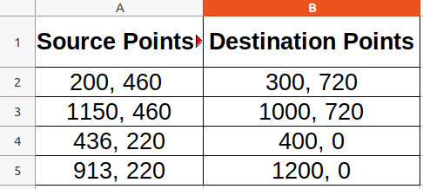
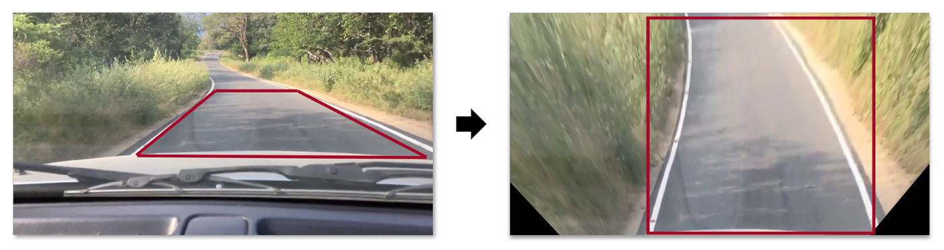
Since, the transform Matrix (M) is defined by 8 constants that is degree of freedom, thus to find the M matrix, I selected the four points (See Figure : 5) in the input image and mapped them to 4 desired location points in the unknown output image. I had to consider the image dimensions for selecting the input points.
Figure : 6 will demonstrate the perspective transform applied to the road lane.
Figure : 5 – Source and Destination Points
Figure : 6 – Perspective Transform on Road lane

Slide 8
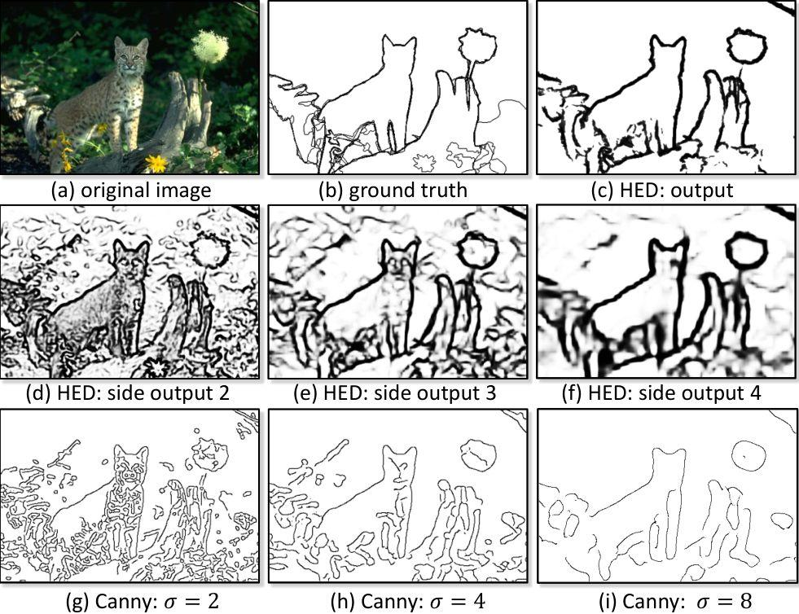
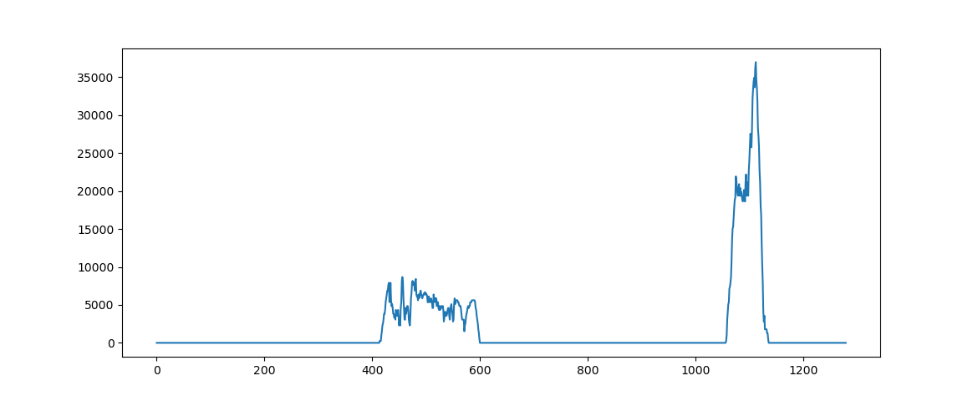
3) Thresholding
This step includes the segmentation of the input image after lane lines are parallel. We know that lanes are either white or yellow based. The input image still contains R, G and B channel information. I eliminated the other channels that I do not need by converting the input transformed image into a single channel grayscale image. Another approach that can be used here was using S channel from HLS converted input image. S channel usually provide good results even if there are fluctuations in lighting conditions. This paper contains the thresholding approach used to convert perspective transform into binary image.
I have tuned the minimum and maximum threshold manually by trial and error methods. I have selected 220 values as minimum threshold while 225 as maximum threshold value.
Now, we have preprocessed a transformed binary image, for finding lanes, we first locate and map the lanes in the image space. I plotted the histogram of pixels that are non zero in lower half of thresholded binary image. The peaks in histogram of binary image indicate lane lines where non-zero pixels are present.
See Figure : 9 for this. X coordinate from histogram is considered to be starting point to search for the respective lanes. I have applied the concept of sliding window, that is a window with a margin is being placed around the line’s center one for each left and right lane.
For finding lane pixels, I took histograms of regions along the columns, see attached Figure : 10. I have identified the peaks and then used these peak positions as a starting point to draw windows on the lane marks.
See Figure : 11 for this.
4) Finding Lane Pixels
Figure : 9 – Histogram of pixel = x , y = count

Slide 9
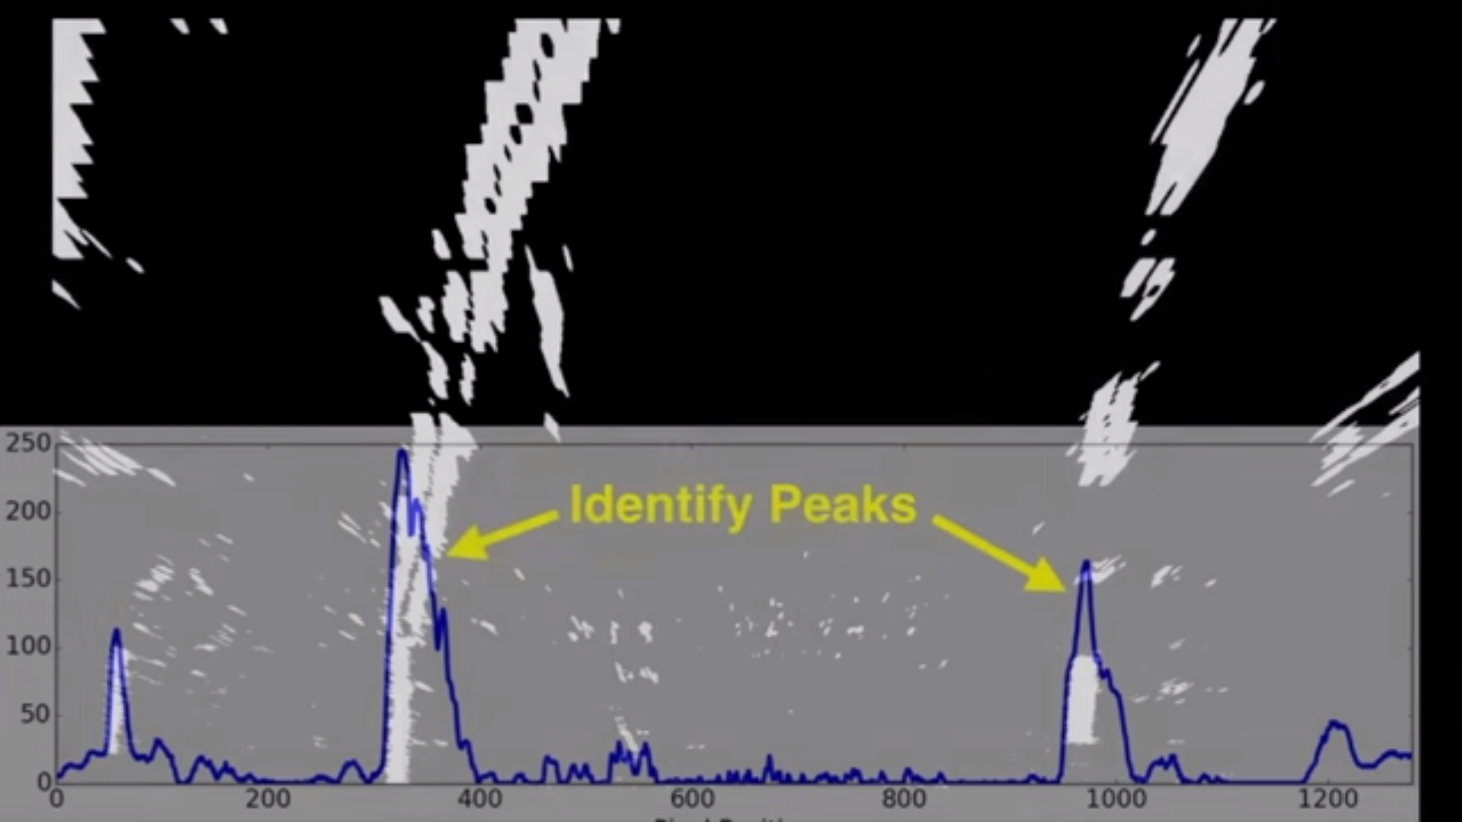
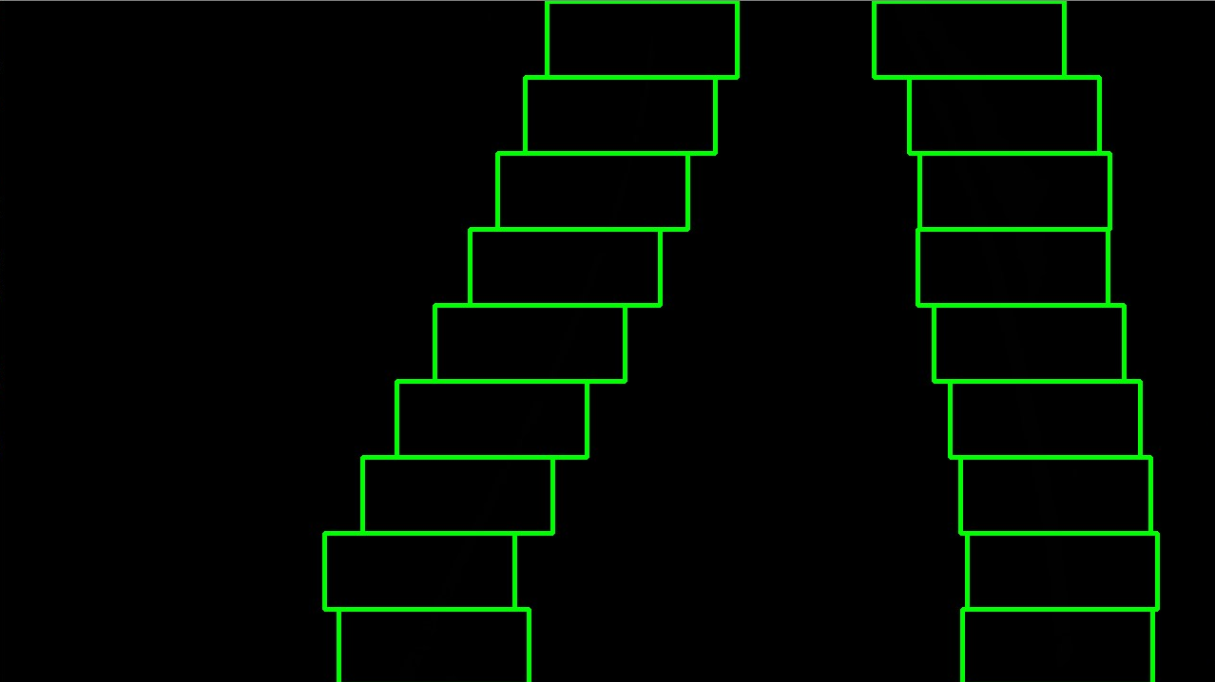
Figure : 10 – Identifying peaks from Histograms
Figure : 11 – Sliding windows

Slide 10
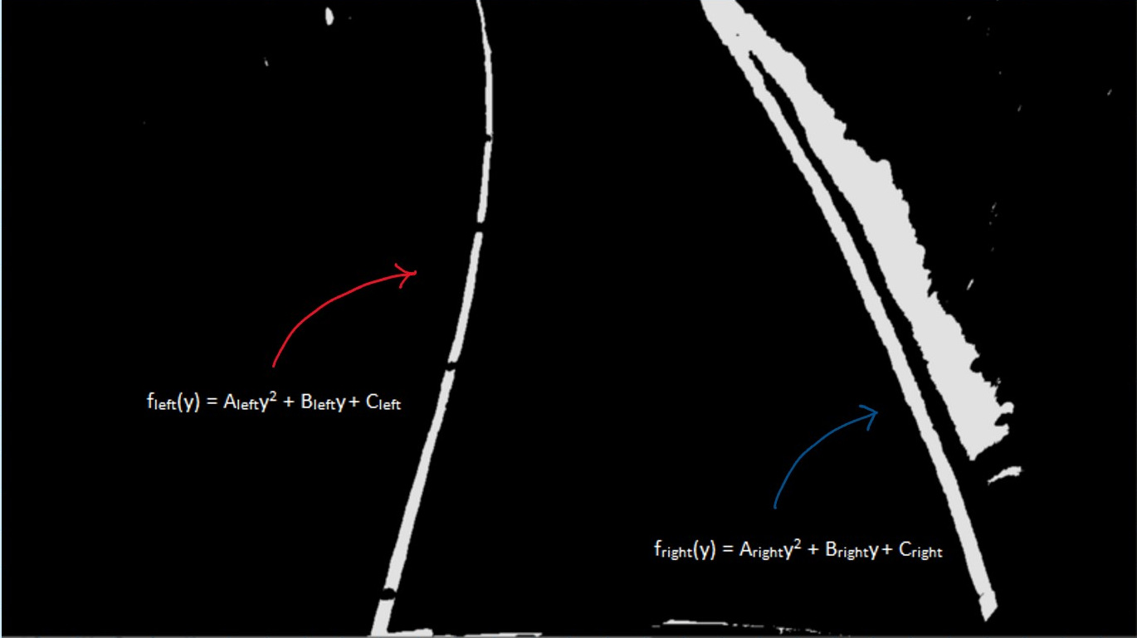
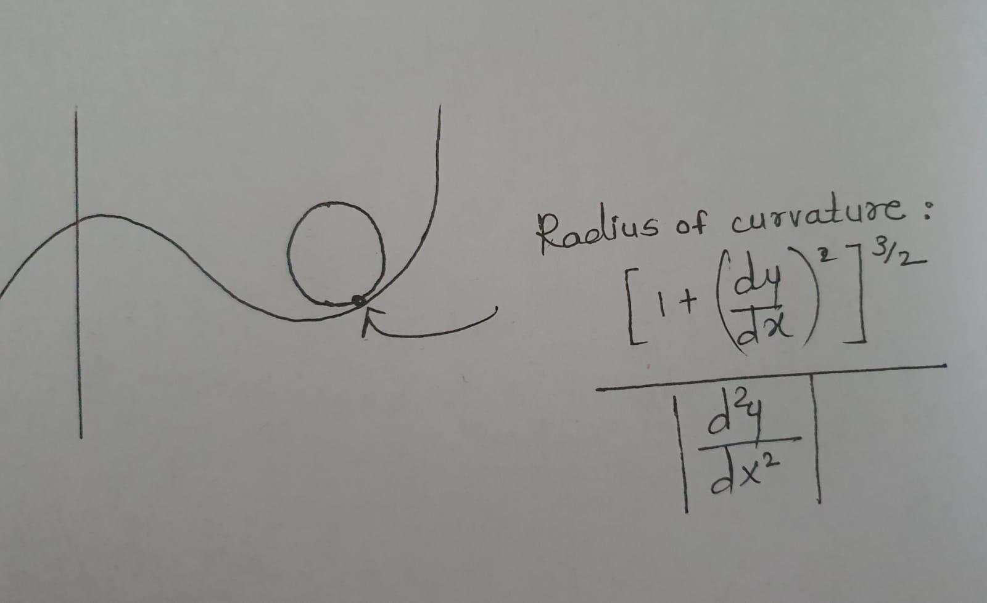
5) Recognizing the lane area
The sliding window gives us the estimated center value of lane area, using these x and y pixel positions, the custom searches around these polynomial curves and tries to fit the second order polynomial curve. See Figure : 12 for the same.
To calculate with a circle that closely fits nearby points on a local section of a curve as seen in figure 13. The radius of curvature of the curve at a particular point can be defined as the radius of the approximating circle.
The last step would be to highlight the lane area by fitting a polygon between these points and projecting it back on to the original image .The lane area and radius of curvature have been computed in image space based on pixel values which is not the same as real world space, hence they have to be converted into real world values, this involves measuring the length and width of the section of lane on which we are projecting our warped image. For simplicity, we can assume that most lanes are going to be usually 30 meters long and 3.7 meters wide and the code uses these values to convert pixel space values to real-world meter measurements.
Figure : 12 – Fit the second order polynomial on detected lanes.
Figure : 13 – Radius of curvature

Slide 11
Results
The project was tricky to implement. I used trial and error techniques for adjusting threshold values and changing color space. The parameters can be tuned to work well on both tracks, but it may fail under the different conditions like during night or different weather conditions. Also, it may fail if another car is close ahead.
The work-flow explained in this paper works perfectly on data such as following
Adjusting brightness might work for some parts of the road (e.g. under the bridge) but fail when it's very light or vice versa. I believe that checking the density of the pixels would indicate that it's too bright or too dark therefore increasing/decreasing threshold runtime could give better results.

Slide 12
Potential Issues or Failures
Currently, sliding windows are stacked vertically and only move horizontally, but the harder challenge road is very curved and stacking only vertically loose the line. Moving windows not only horizontally but also adjusting vertically may improve line detection. It is something worth trying in the future.

Slide 13
Conclusion
To begin with, the approach explained in this paper is a good solution to solve the lane detection problem with pure computer vision techniques. To get more consistent and comprehensive results, we can also use neural network techniques especially when input data frames contain varying lighting and surroundings conditions.
The biggest problem that I faced with this approach is that : it is a difficult process to create the composition of thresholds. This pipeline may fail if there is variation in the light, shade, and noise of the surroundings. There is also a possibility that the thresholded image may not always capture the lane lanes and the information that we really need to extract. But this is not an ideal solution, and we need a more powerful algorithm that can compose a set of filters that can learn and construct the output in a more consistent way. Because of that, I think that we cannot completely solve the problem with computer vision, we need machine learning or a convolutional neural network algorithm that can learn how to annotate the road lane lines.
The pipeline fails in low light conditions where the lanes are not visible on lots of continuous frames. This was observed during the testing of the pipeline on low light condition videos.

Slide 14
Thank You !

